Slide 1

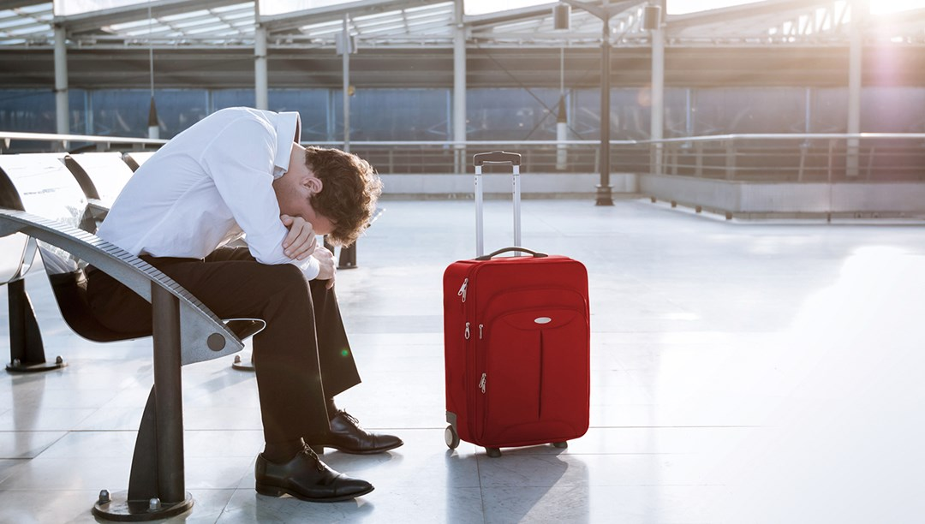
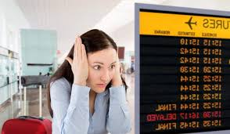
Flight Delays
Has this been you?

Slide 2
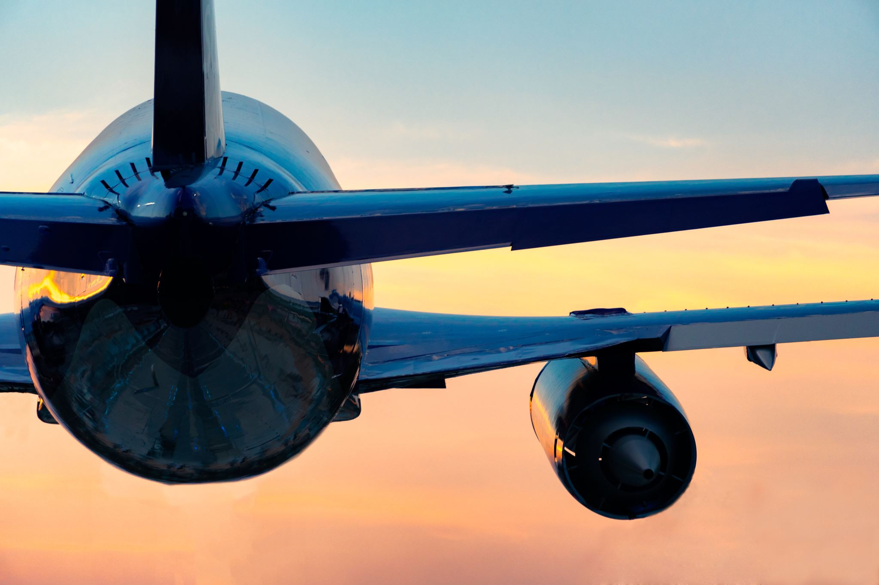
How much do delays cost?
Odds of a delayed flight?
1Q 2022 20.5%
2021 11.4%
2020 10.2%
2007 study says
$ 8.3 billion a year to airlines.
$16.7 billion to passengers

Slide 3
Reasons for delay
Carrier
Traffic (NAS)
Weather
Security
Late Aircraft

Slide 5
Can Machine Learning Reduce Weather Delays?
Random Forest Classifier can predict with 69.25% accuracy if a flight will be delayed based on the date and time it is scheduled to land in MIA
Model can be used to build schedules and avoiding peak weather delay periods.
Expanding to other hub cities can help reduce traffic delays immensely.

Slide 6
The Data
Bureau of Transportation and Statistics
Every arriving flight to MIA starting June 2006 until January 2023
329,362 flights analyzed
Focused on the summer months of May – September
Most amount of weather delays
Data was cleaned and analyzed to prepare for machine learning

Slide 7
Data Analysis
Average delay for a flight is
15.62 minutes
Mean time for a late arrival
5:42 pm

Slide 8
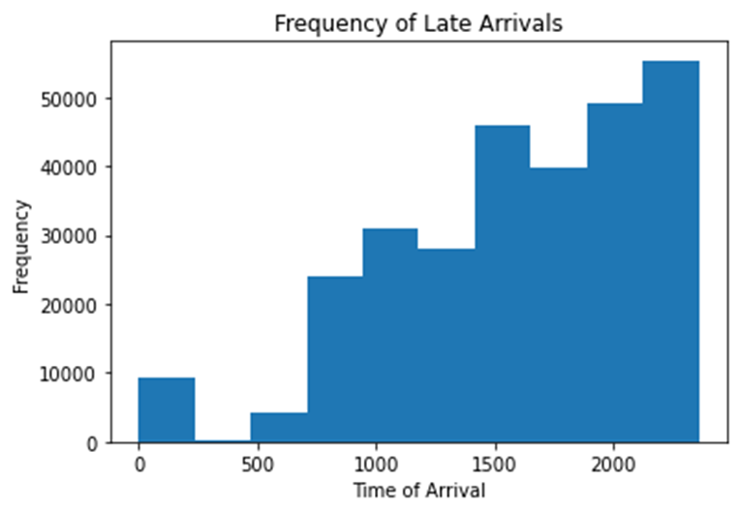
Data Analysis: Late Arrivals

Slide 9
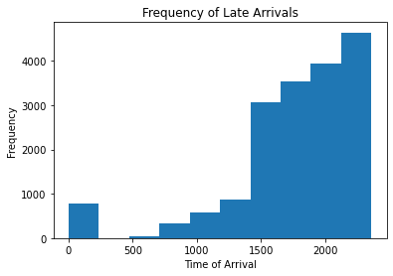
Data Analysis: Late Arrivals due to weather

Slide 10
Creating a Model
Data was split in a 66% training and 33% testing.
Due to imbalance in the data, used SMOTE to create more minority points.
ROC analysis is a useful tool for evaluating accuracy of a statistical model into 1 of 2 categories
On-time or delayed
Used ROC-AUC scoring to better interpret results.

Slide 11
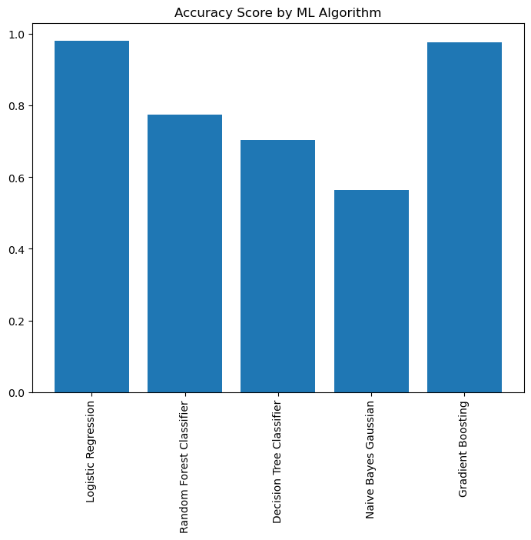
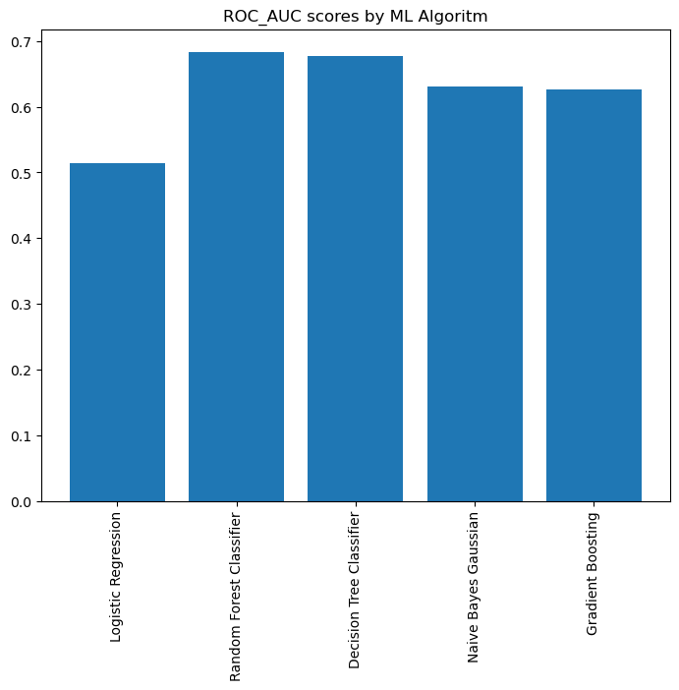

Slide 12
Random Forrest Classifier
Returned a 68.37% accuracy broken down to
99% accuracy with on-time flights.
59% accuracy with delayed arriving flights
Hyper tuning returned a lesser score
55.5% ROC_AUC score
Feature Importance Analysis provided slight improvement.
ROC-AUC score improved to 69.25%

Slide 13
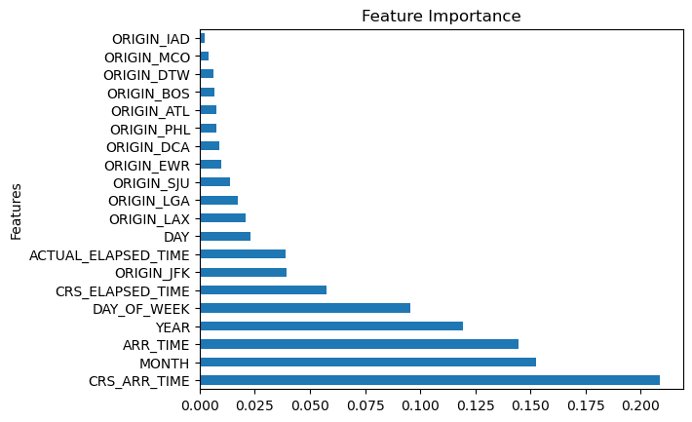

Slide 14
Continued Work
Develop a model for departures
Breakdown data by month
Expand work for other hub cities.
Develop route network and schedule that avoids each hubs time slots with most delays.

